Slide 1

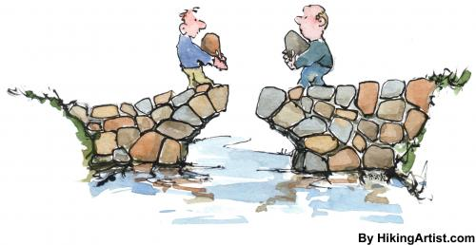
Tri-State AAAEA invites you to join us in:
Building Knowledge
Learn from Industry Leaders
Anabella Hedman
Assistant Vice President, CES
To CODE, or Not To CODE?, Creating Opportunities for Diversity & Ethnicity
Suhail Albhaisi, PhD, PE
Senior Bridge Engineer, JACOBS
The Rehabilitation of The Alexander Hamilton Bridge
Khaled T. Husein, CCM
Vice President, HAKS
Certified Construction Manager (CCM) Certification
L a y a l i D u b a i R e s t a u r a n t
24-17 Steinway Street, Astoria, NY 11103
Saturday, March 7, 2015
5:00 PM – 8:00 PM
For RSVP, contact Reema Albahri at Reema.Albahri@aaaea-tristate.com

